Slide 1
Are you ready to ….. finish Middle School?
8th Grade Registration

Slide 2
Middle School Course Catalog
- Digital copy available on 7th to 8th grade registration page
- Go to:
- Eisenhower Middle School’s website
- Counseling
-Middle School Course Catalog 2025/2026
Live it, love it!

Slide 3
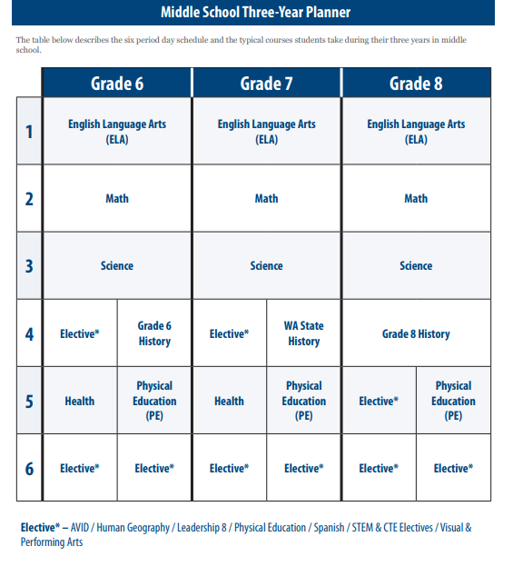
8th Grade Plan
All Year Classes
English
Math
Science
History
Semester Classes
3 semesters of elective classes
OR
4 semesters of elective classes (if you are choosing 2 yearlong electives such as Band & Spanish 1)

Slide 4
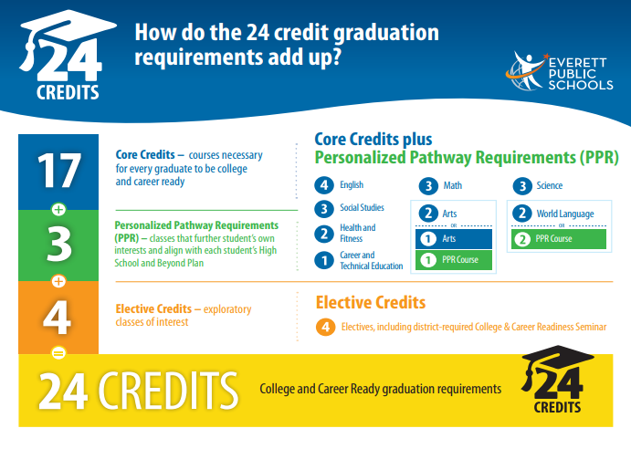
HS Graduation Requirements (page 9 of course catalog)
HS Schedule:
6 Class Periods/Day
Each semester class is worth .5 credits. Total of 6 credits earned per year.
6 Credits x 4 Years =
24 credits

Slide 5
Earning HS Credit in Middle School
7th Grade:
WA State History
8th Grade: Algebra/Geometry, Pre-AP English 1, Spanish 1, Coordinated Science, Exploring Graphic Arts, Digital Manufacturing, Robotics Tech I and II
6th Grade
Everyone can earn .5 credit.
Ability to earn H.S. credits in 8th grade.

Slide 6
Core Content Choices
English 8​
Pre-AP English 1 (HS Credit)​
​
Math 8​
Algebraic Concepts (HS Credit)​
Geometry in Application (HS Credit)​
​
Science 8​
Coordinated Science (HS Credit)
History 8 – Required for all students
English
Math
Science
Social Studies
Notes:
Linda

Slide 7
Class Options for 8th grade
English
6th Grade English Honors English (7)
7th Grade English Honors English (8)
8th Grade English Pre-AP English 1
(HS Credit)
9th Grade 9th Grade
Pre-AP English 1 Pre-AP English 2
Math
6th Grade Math Accelerated Math 6
7th Grade Math Accelerated Math 7
8th Grade Math Algebra
(HS Credit)
9th Grade 9th Grade
Algebra (CHS) Geometry
Geometry (EHS)
Summer School
If you are interested in moving into Pre-AP English 1, please complete an application by Friday March 28th.
Students will be enrolled in the next math course. If you are interested in moving into Algebra and you are not currently in Accelerated Math 7 class, there is a summer school class available to you at no cost.

Slide 8
Class Options for 8th grade
Science
6th Grade Science 6th Grade Science
7th Grade Science 7th Grade Science
8th Grade Science Coordinated Science
(HS Credit)
9th Grade
Biology and the OR AP Environmental
Environment Science
Coordinated Science is a choice class in 8th grade. It is a 9th grade, HS credit course. Students should be self-directed, have high grades in 7th grade Science and have a passion for learning about Science and Math.

Slide 9
Electives
PE electives are the only classes you may repeat.
You MAY sign up for Integrated Tech II and/or Robotics II if you took Integrated Tech I and/or Robotics I in 7th grade.

Slide 10
Visual and Performing Arts Requirement
All students must take at least one semester of a Visual OR Performing Arts class.
Classes that meet the state requirement:
Band
Choir
Orchestra
Art
Exploring Graphic Arts (CTE and Art credit)
Spanish, AVID and STEM/CTE classes do NOT meet the state requirement for visual and performing arts.

Slide 11
Visual and Performing Arts Elective Choices
Year-Long Options:
Band I, Band II or Band III
Prelude, Intermezzo and Chamber Orchestra
Choir III (8th Grade Choir)
Semester Options:
Art 8
Yearbook
Exploring Graphic Arts
See course catalog for class descriptions.

Slide 12
Elective Choices
STEM/CTE Elective options – classes are one semester
Integrated Technology I and II
Robotics Tech I and II (.5 HS credit each semester)
Digital Manufacturing (.5 HS credit)
Exploring Graphic Arts (.5 HS credit) - also meets art requirement
See course catalog for class descriptions.

Slide 13
Additional Electives:
Yearlong (2 semesters)
Spanish 1 (1.0 HS credit)
AVID 8
See Ms. Dunsire about AVID. Option not available for selection in HAC

Slide 14
Spanish 1
High School World Language Credit Course
2 years required for HS graduation and minimum college entrance requirement
Completion of 3+ years in HS meets college entrance and exit requirements (for some colleges/programs)
Grade must be transcripted in order to recive the credit
Instructional Focus
Culture & Traditions
Learning Skills:
Speaking & Listening
Reading & Writing
Preparation for learning in a Global Society

Slide 15
PE Elective Choices
Students will be required to take one semester of Physical Education - Foundational 8
You may retake PE electives you had in 7th grade
PE Electives: (one semester)
Lifetime Individual Sports and Fitness
Team Sports
See course catalog for class descriptions.

Slide 16
High School Credit Courses
Reminder: The courses listed below are all HS level content and are for credit. Grades and credit are automatically placed on your HS transcript when you move up to 9th grade.
Pre-AP English 1 Spanish 1
Algebra and Geometry Coordinated Science
WA State History (.5 Credit , students will be enrolled if not previously completed in 7th grade)
Exploring Graphic Arts Robotics Tech I and II
Digital Manufacturing
Students: Make sure you have a school/life balance! Do not take so many HS courses that you are stressed or overwhelmed. Challenge yourself, but remember, 8th grade is not HS!

Slide 17
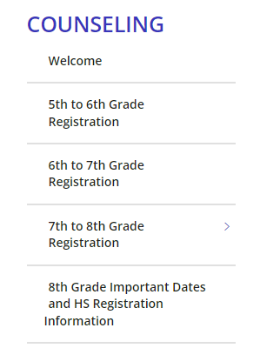
Registration Materials and Course Catalog
All class descriptions are in the course catalog.
Click on the 7th to 8th Grade Registration link to see all registration materials:

Slide 18
Class Choices in HAC
All students will be entering next year choices into Home Access Center (HAC) with Ms. Burdick during English classes.
March 4th – Ms. Stork
March 10th – Ms. Woodhouse
HAC will be open for course request changes until March 21st, 2025.
Please see Ms. Burdick if you have questions.
Call 425-385-7514
Email sburdick@everettsd.org

Slide 19
Selecting Courses in Home Access Center (HAC) HAC will be open for course request changes until March 21st, 2025. Go to everettsd.org Click “Grades and More”

Slide 20
Home Access Center (HAC)
Log onto your device go to the Eisenhower Home page
Click on the A+ ‘Grades and More’
Click on the blue ‘Home Access Center’ button
Login
Click on ‘Classes’
On the left, click on the ‘Request’ tab
On the same row as No Department, click on the ‘edit’ button on the right
Check the boxes to choose your classes for next year
When done SAVE and then Exit.

Slide 21
Log in using your school ID and password

Slide 22
Click on Classes, then the Request tab
1
2

Slide 23
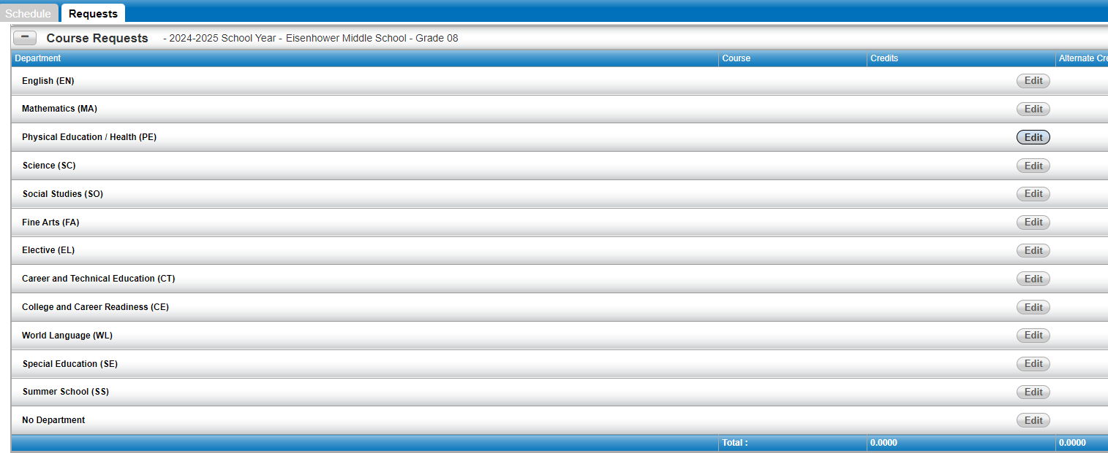
You need to select courses in 4 departments.
(Click on the Edit button to view courses.)
Fine Arts, Science, Electives
Ignore These

Slide 24
Science 1. Choose Science 8 or Coordinated Science Honors 2. Click the box next to your choice and SAVE.

Slide 25
Fine Arts - Check the box next to your choice(s) and SAVE.

Slide 26
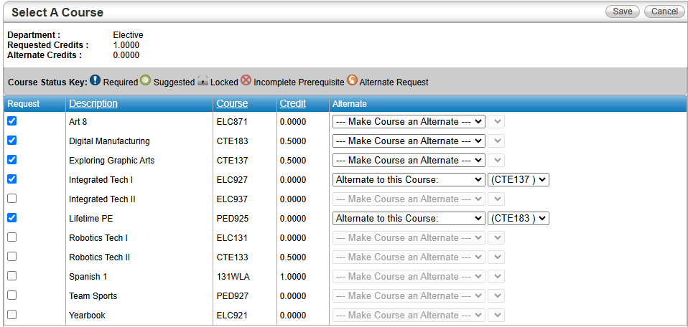
Electives
- Click the box next to your choices and SAVE.

Slide 27
Questions?
HAC will be open for course request changes until March 21st, 2025.
If you have any questions about courses or registration, please send me an email.
sburdick@everettsd.org

